Slide 1
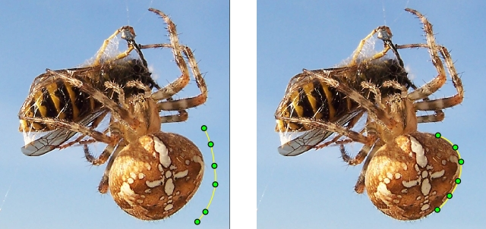
Active Contours
Adam Hoover

Slide 2
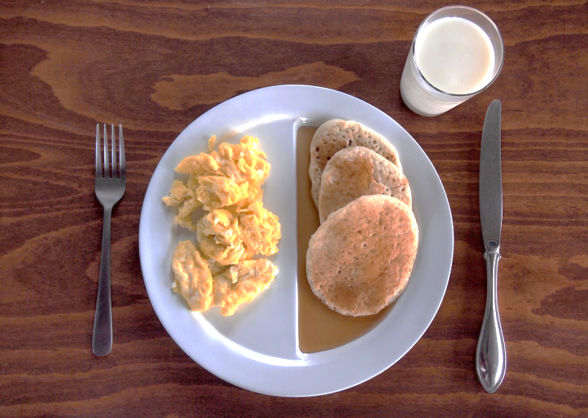
Motivation
Start: rough initial contour
active
contour
algorithm
End: desired final contour

Slide 3
Control points
Control points = every Nth pixel on contour
Active contour algorithm only operates on control points
All other pixels in contour are interpolated (linear or curved) between control points

Slide 4
Control point energy
W
W
For each control point, calculate energies in a W x W window around it
Note: it does not matter if other control points are in the window or not

Slide 5
Internal energy
W
Based on locations of control points
i+1
Note: does not matter how many (if any) control points are in the window; we know all their locations regardless
i
i-1
Second note: we pick a formula to describe the internal energy
Window for control point ‘i'

Slide 6
Example internal energy formula
E_{internal} = (x_{i} - x_{i+1})² + (y_{i} - y_{i+1})²
2
37 26 17 10 5 2 1
1
i+1
1
36 25 16 9 4 1 0
0
2
37 26 17 10 5 2 1
1
i
40 29 20 13 8 5 4
45 34 25 18 13 10 9
i-1
52 41 32 25 20 17 16
61 50 41 34 29 26 25
Current locations of control points
If we move ‘i’ to the given location, how far is it from ‘i+1’?

Slide 7
External energy
W
11 24 27 23 11 8 5
Based on image data
10 22 25 25 10 9 5
12 20 27 20 12 8 4
Note: we pick a formula to describe the external energy
10 20 24 22 10 8 5
9 21 29 20 11 7 5
10 24 23 25 10 6 6
11 20 20 27 14 8 5
Example window of image data around control point ‘i'

Slide 8
Example external energy formula
E_{external} = -I(x_{i,}y_{i})
11 24 27 23 11 8 5
-11 -24 -27 -23 -11 -8 -5
10 22 25 25 10 9 5
-10 -22 -25 -25 -10 -9 -5
12 20 27 20 12 8 4
-12 -20 -27 -20 -12 -8 -4
10 20 24 22 10 8 5
-10 -20 -24 -22 -10 -8 -5
9 21 29 20 11 7 5
-9 -21 -29 -20 -11 -7 -5
10 24 23 25 10 6 6
-10 -24 -23 -25 -10 -6 -6
11 20 20 27 14 8 5
-11 -20 -20 -27 -14 -8 -5
Window of image data around control point ‘i'
External energy around control point ‘i'

Slide 9
Total energy
E_{total} = E_{internal} + E_{external}
37 26 17 10 5 2 1
-11 -24 -27 -23 -11 -8 -5
26 2 -10 -13 6 -6 -4
36 25 16 9 4 1 0
-10 -22 -25 -25 -10 -9 -5
26 3 -9 -16 -6 -8 -5
37 26 17 10 5 2 1
-12 -20 -27 -20 -12 -8 -4
25 6 -10 -10 -7 -6 -3
40 29 20 13 8 5 4
-10 -20 -24 -22 -10 -8 -5
30 9 -4 -9 -2 -3 -1
45 34 25 18 13 10 9
-9 -21 -29 -20 -11 -7 -5
36 13 -4 -2 2 3 4
52 41 32 25 20 17 16
-10 -24 -23 -25 -10 -6 -6
42 17 9 0 10 11 10
61 50 41 34 29 26 25
-11 -20 -20 -27 -14 -8 -5
50 30 21 7 15 18 20
Internal energy around control point ‘i'
External energy around control point ‘i'
Total energy around control point ‘i'

Slide 10
Minimum energy
26 2 -10 -13 6 -6 -4
i+1
26 3 -9 -16 -6 -8 -5
25 6 -10 -10 -7 -6 -3
30 9 -4 -9 -2 -3 -1
i
36 13 -4 -2 2 3 4
42 17 9 0 10 11 10
50 30 21 7 15 18 20
i-1
Total energy around control point ‘i'
Control point ‘i‘ will move to location with minimum total energy
Note: control point ‘i‘ does not move yet! Make same calculations for all control points first.

Slide 11
Loop over all control points
W
‘i'
W
‘i+1'
…
W
After new locations for all control points calculated:
Move control points
Interpolate pixels between control points (if desired)
W

Slide 12
Loop multiple iterations
…repeat…
Start
Iteration 1 through all control points
T iterations
End
Contour moves a little each iteration, until it settles or T iterations have finished

Slide 13
Lots of options
E_{total} = E_{internal} + E_{external}
Internal energy formula (what force does our example exert?)
External energy formula (what force does our example exert?)
What do you think is the most common?
Control point distance N (what is the benefit of larger and smaller?)
Window size W (what is the effect/tradeoff of a larger vs smaller window?)
Number of iterations T
E_{total} = K₁E_{internal1} + K₂E_{internal2} + K₃E_{external1} + K₄E_{external2}
Can use multiple internal and multiple external energies
Can weight energies; to do so they must typically be normalized

Slide 14
When to use?
“Snap to” outlining of things
Video tracking (frame to frame)

