Slide 1
Measuring Digital System Latency from Sensing to Actuation at Continuous 1 ms Resolution
Weixin Wu, Yujie Dong, Adam Hoover
Dept. Electrical and Computer Engineering,
Clemson University

Slide 2
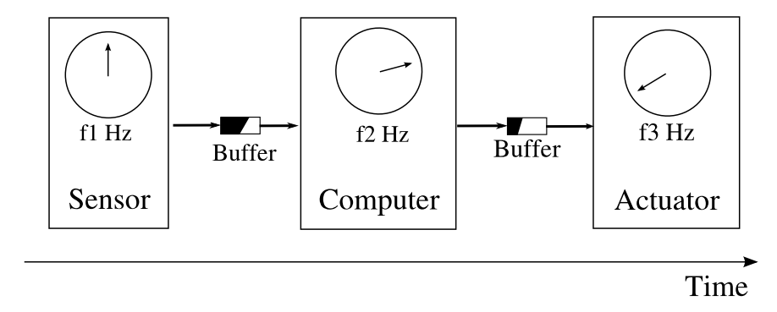
What is system latency
Delay from when an event is sensed to when the computer “does something” (actuates)
Examples: camera to display; gyroscope to motor

Slide 3
Why do we care?
If delay is constant, human users can adapt, machine systems can be built to specification
Time
Constant delay

Slide 4
What if it is not constant?
May have some relation to “simulator sickness”; machines have to be built with a lot more tolerance for variability in delay
Time
Varying delay

Slide 5
How do we measure it?
Components use asynchronous clocks; computer timestamps do not include sensing/actuation times or variability in buffers
unmeasured
unmeasured
Timestamp
Timestamp

Slide 6
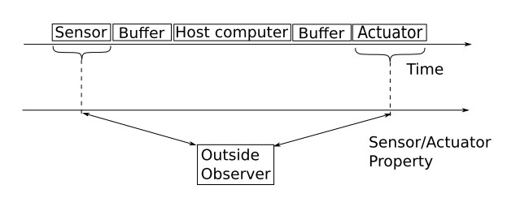
Indirect system latency measurement
Outside observer
Measure when the property being sensed/actuated are same
Example: marker position in “real world” matches marker position in “display”

Slide 7
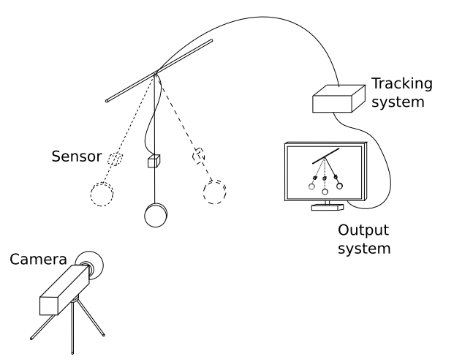
Previous works (camera based)
Actuator
Sensor
  Bryson & Fisher (1990)
  He, et. al. (2000)
  Liang, Shaw & Green (1991)
  Ware and Balakrishan (1994)
  Steed (2008)
  Morice et. al. (2008)
Outside observer

Slide 8
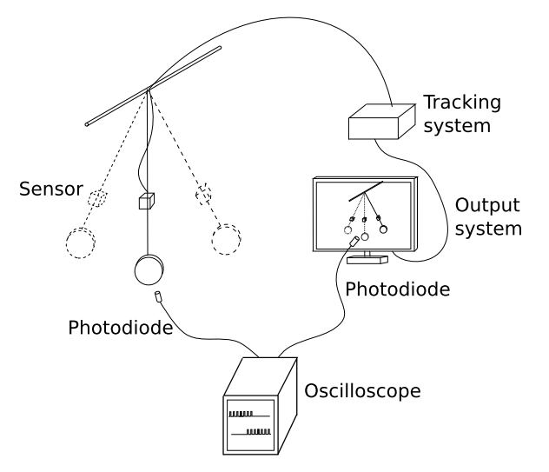
Previous works (event based)
  Mine (1993)
  Akatsuka & Bekey (2006)
  Olano et.al. (1995)
  Morice et. al. (2008)
  Teather et. al. (2009)
Outside observer

Slide 9
Why measure continuously?
Measure:
Time
Average infrequent or irregular measurements

Slide 10

Continuous measurement
Outside observer is high speed camera
Can capture 480 x 640 image resolution at 1,000 Hz for up to 4 seconds

Slide 11
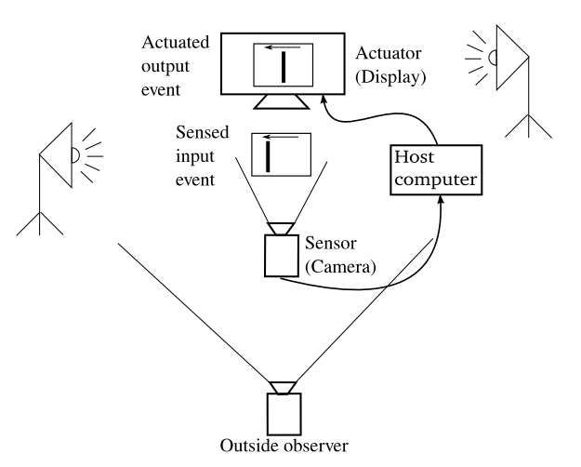
Experiment 1: camera to display

Slide 12
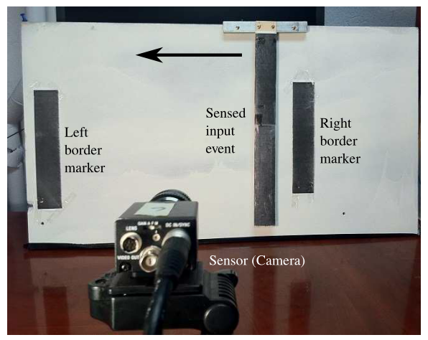
Sensor, object in “real world”
Bar is manually moved right to left in about 1 second

Slide 13
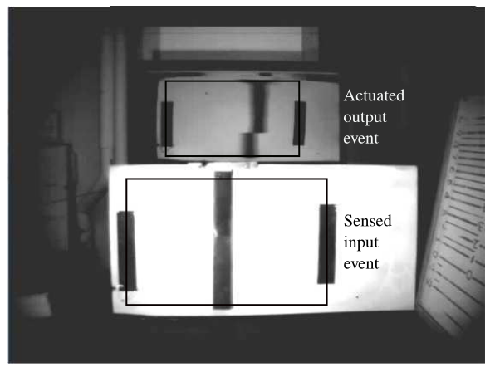
As seen by outside observer
Bar position in display lags behind bar position in real world

Slide 14
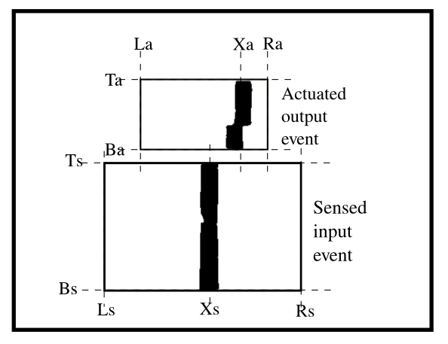
Automated image processing
Calculate P=(X-L)/(R-L) for both events

Slide 15
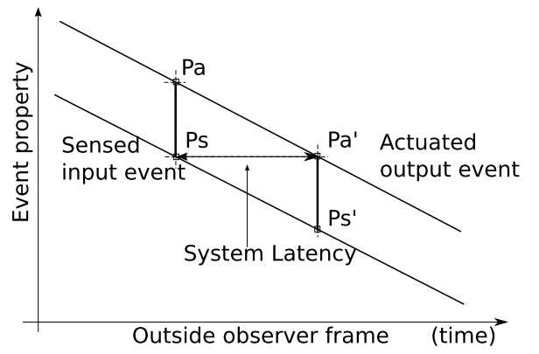
Continuous latency measurement
Plot Ps and Pa for each high speed camera frame

Slide 16
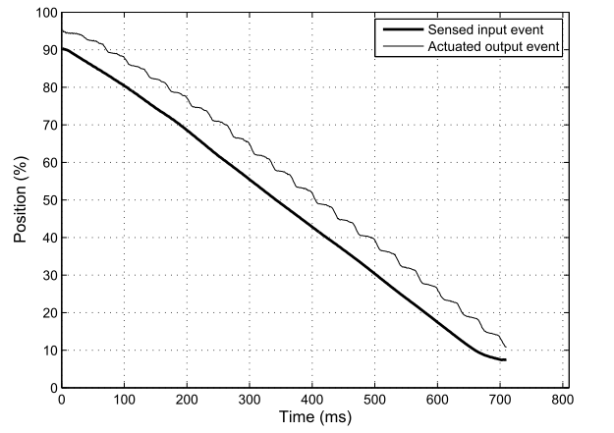
Result
frequency
magnitude
Delay varies with 17 Hz oscillation, 10-20 ms magnitude

Slide 17
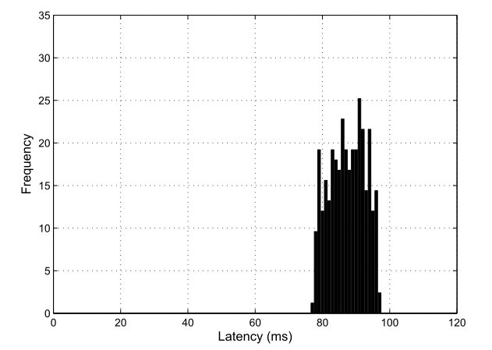
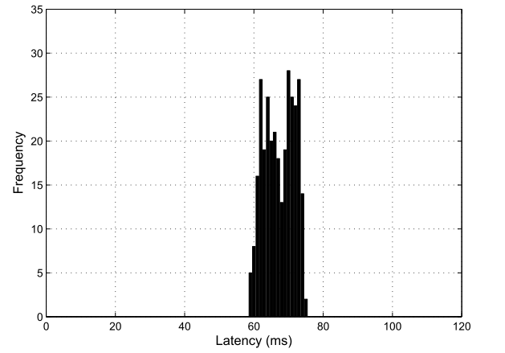
Result
Histograms, or averages, do not provide the whole picture

Slide 18
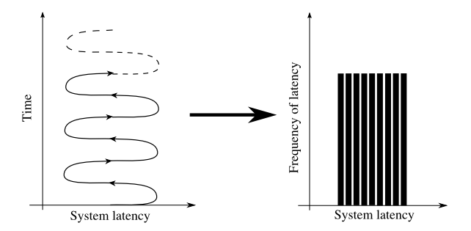
Modeling the variability
The histogram of delay is uniform but NOT random

Slide 19
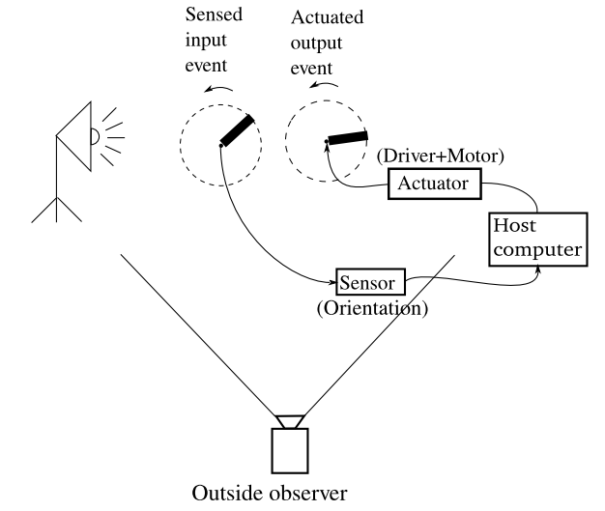
Experiment 2: gyroscope to motor

Slide 20
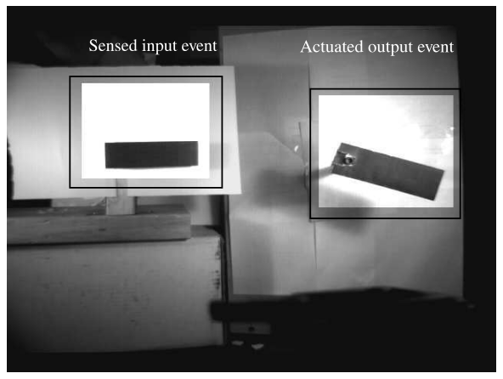
As seen by the outside observer
Bar on motor lags behind bar being manually rotated

Slide 21
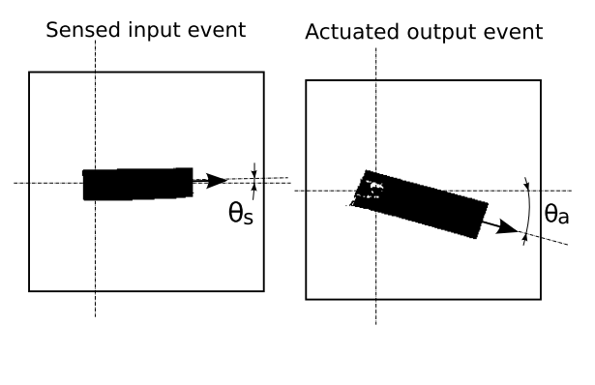
Automated image processing
Calculate theta for both events (relative to initial theta)

Slide 22
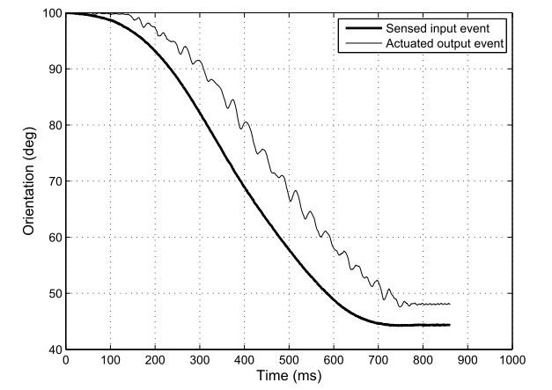
Result
Similar high frequency/magnitude variability as in experiment 1

Slide 23
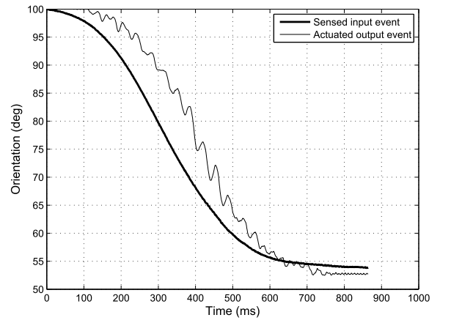
Result
Lines are not parallel – lower frequency variability
Changes every trial, due to varying sensor error

Slide 24
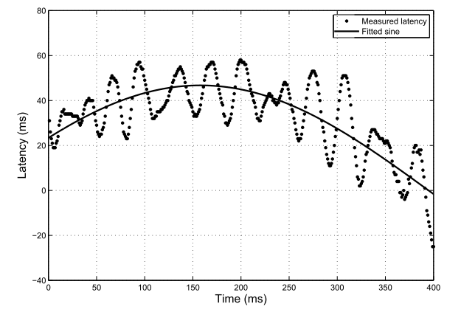
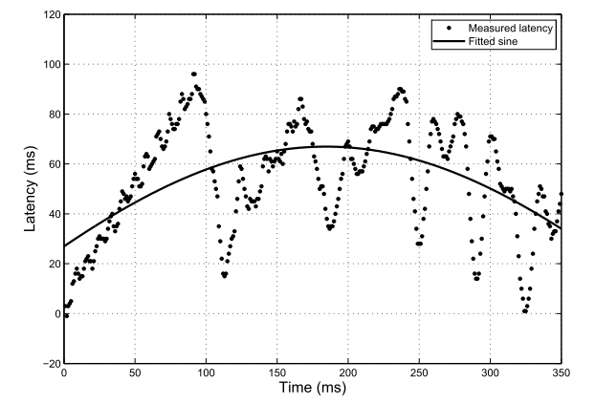
Fitting sinusoid to low frequency
Two examples:
Ten trials of 50 degree rotation in 800 ms:
  0.5-1.0 Hz variability in delay, magnitude 20-100 ms
Seven trials of 10 degree rotation in 800 ms:
  0.5-1.0 Hz variability in delay, magnitude 20-100 ms

Slide 25
Conclusion
Measuring delay continuously at 1ms resolution shows interesting variations in latency
Relation to simulator sickness?
Next experiments: control latency variability, test its effect on people

