Slide 1
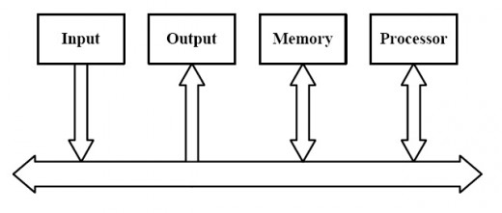
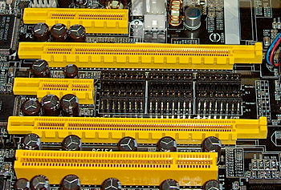
Computer buses
Adam Hoover
connecting stuff together
bus you may have seen
does anything besides bandwidth matter?

Slide 2
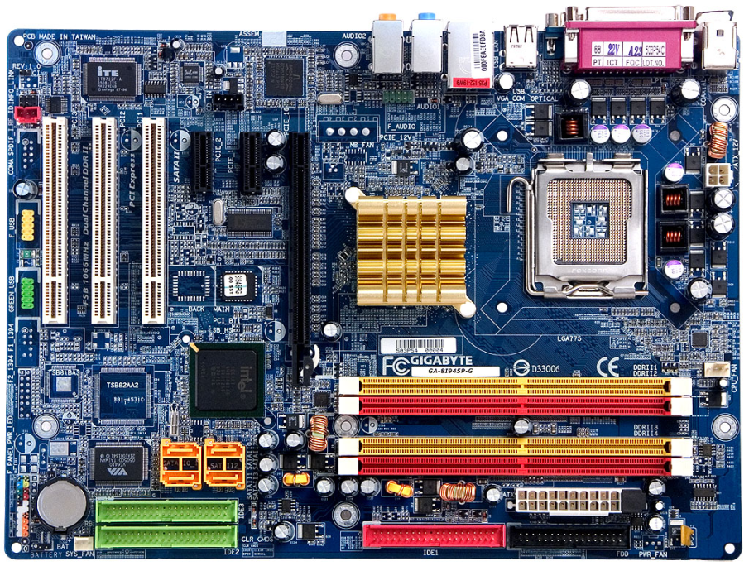
Bus vs Network
network
motherboard example of
many buses including PCI express (I/O), HyperTransport (chip to chip), SDRAM (memory),
DVI (video)
Buses and networks operate on same basic principles.
(This lecture focused on wired options.)

Slide 3
Connecting chips
common ground
chip A
chip B
chip C
+3 V
+5 V
0 V
receiver
0 V
driver
1 0 0 1
1 1 0 0
data flow
If every chip is wired to every other chip this way, we run out of pins and the wires become the dominant weight.

Slide 4
Connecting chips via bus
common ground
bus (1-N wires)
chip A
chip B
chip C
Multiple drivers/receivers must coordinate somehow.
Many design choices for number of wires and uses.

Slide 5
Transmission
single-ended transmission
differential transmission
Differential provides better noise immunity at cost of extra wire and complexity in driver/receiver.

Slide 6
Transmission directions
simplex
driver
receiver
half duplex
driver/receiver
driver/receiver
driver
receiver
full duplex
receiver
driver
Varying complexity in driver/receiver (hardware and software).

Slide 7
Collisions
common ground
bus (1-N wires)
voltage collision!
+3 V
+3 V
0 V
0 V
1 0 0 1
1 1 0 0
chip A
chip B
driving
driving
Arbitration strategies include:
Voltage monitoring with random wait
Priority schemes
Time slicing (e.g. round robin)

Slide 8
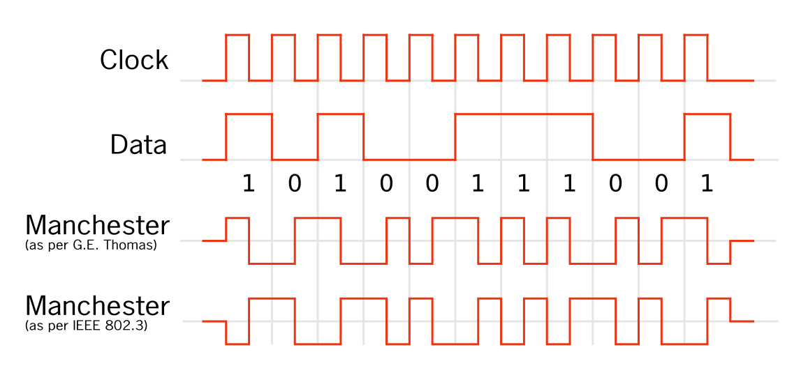
Clock
dedicated clock line
separate data line
clock embedded in data
data = clock XOR manchester
If clock signal embedded, clock rate must be detected and synced at receiver (e.g. serial port).

Slide 9
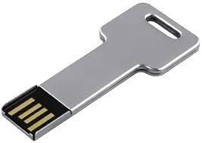
External power supply
dedicated power line
driver
receiver
+5 V powers receiver

Slide 10
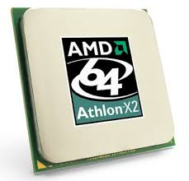
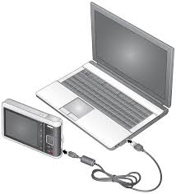
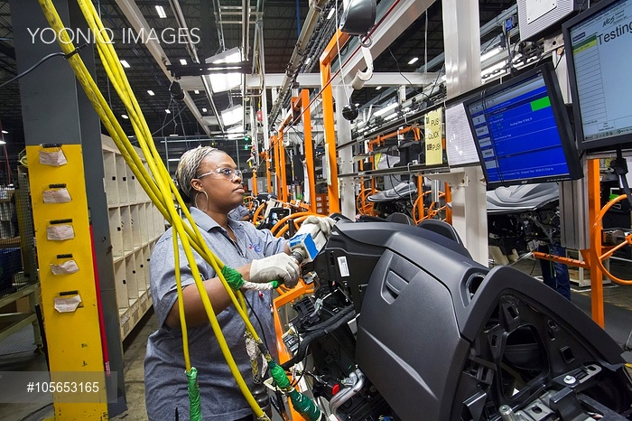
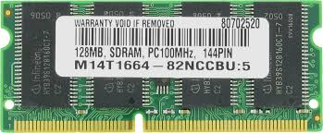
Voltage vs Distance
Example bus | Voltage | Max distance* | Application
SDRAM | 1.05-3.3 V | 10 cm | Memory to CPU
USB | 5 V | 5 m | I/O peripherals
Serial port | 3-25 V | 3-60 m | Varied
*Distance a function of impedance, not just voltage.
Repeaters can extend distances.

Slide 11
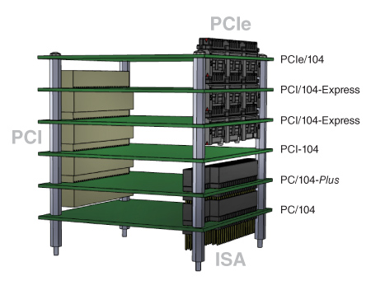
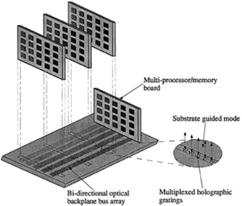
Backplane
Card inserts (e.g. VME, PCI)
Screws, lockdowns, stacks (e.g. PC 104)
Varying levels of ruggedness to vibration and shock.

Slide 12
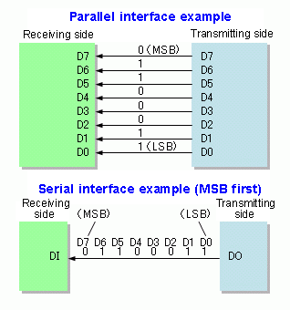
Serial vs Parallel
Advantage: more wires = more bandwidth.
Problem #1: more wires
and chip pins.

Slide 13
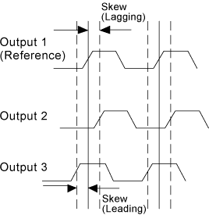
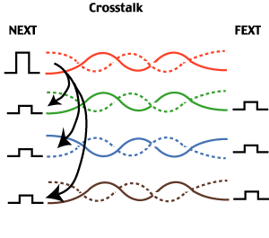
Serial vs Parallel
Problem #2: clock skew
Problem #3: cross talk (reduced by shielding and wire twisting)

Slide 14
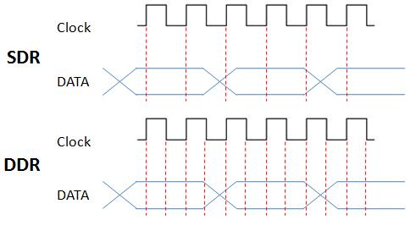
Clock edges
single data rate
double data rate
Buses with low skew and crosstalk can double data rate by using both clock edge transitions to transmit data (e.g. memory to CPU).

Slide 15
Coordinating transmitters/receivers
common ground
bus (1-N wires)
chip A
chip B
chip C
+3 V
0 V
1 0 0 1
Who is chip C sending this message, A or B?

Slide 16
Direct Addressed
common ground
address bus
data bus
chip A
chip B
chip C
0
0
0
1
1
0
Drive/receive controlled by dedicated bus lines.

Slide 17
Packetizing
Suppose driver wants to send receiver the following data:
0
0
1
0
0
0
1
0
1
0
1
0
1
1
1
0
1
0
1
0
0
0
1
1
Create and transmit 3 packets:
source address
destination address
sequence number
0
0
1
0
0
0
1
0
source address
destination address
sequence number
1
0
1
0
1
1
1
0
source address
destination address
sequence number
1
0
1
0
0
0
1
1
Less wires, but more complex driver/receiver and reduced bandwidth (packet overhead).

Slide 18
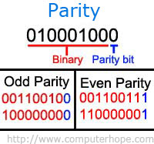
Error checking
Given the following data:
1
0
1
0
0
0
1
1
We can add a parity bit indicating if the number of 0’s is even (0) or odd (1):
1
0
1
0
0
0
1
1
0
Parity bit(s) can be used to detect transmission errors, at the cost of reduced bandwidth.

Slide 19
Bus families and examples
Generic: ISA, VME, PCI, PCI express, RS232 (serial)
* tend to be limited by slowest device
System : HyperTransport (AMD), Quickpath Interconnect (Intel), AMBA (SoC), Wishbone (open source), SDRAM
Video: AGP, HDMI, DVI, DisplayPort
Chip-to-chip: I2C, GPIO, CAN, FlexRay, RS232
I/O: USB, SCSI, Firewire, MIDI, SATA, Thunderbolt
All have different design criteria in terms of bandwidth, distance, error checking, voltage, etc.

Slide 20
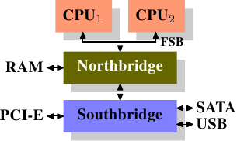
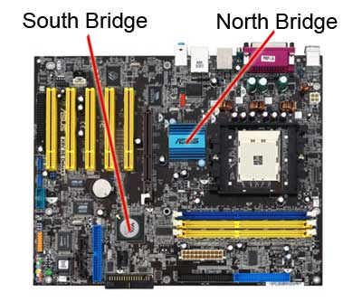
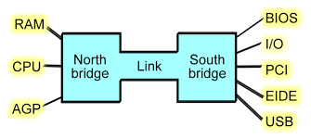
Bridging
Bridges connect buses and can provide point-to-point links between multiple drivers/receivers using subsets of dedicated lines.

