Slide 1
The JPEG codec:
How it works
Adam Hoover

Slide 2
Background
JPEG = Joint Photographic Experts Group
1980’s explosion of digital photography
Researchers (compression, image processing)
Camera makers (Kodak, etc.)
Data carriers (Bell, AT&T, etc.)
File format is JFIF (JPEG File Interchange Format)
Lossy codec only intended for photographs

Slide 3
Color space
Convert RGB -> YUV
Y = 0.299R + 0.587G + 0.114B
U = -0.1687R – 0.3313G + 0.5B + 128
V = 0.5R – 0.4187G – 0.0813B + 128
Y is luminance
U,V are blue chrominance, red chrominance
Human vision is more sensitive to luminance than chrominance

Slide 4
Data units
Images are divided into 8x8 pixel blocks
Each block is treated independently
Every Y is retained
U,V are averaged over 2x2 blocks
Y | Y
Y | Y
U,V

Slide 5
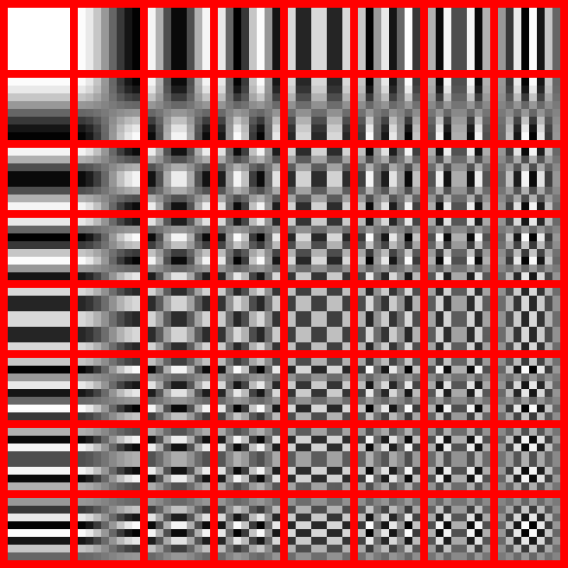
Discrete cosine transform (DCT)

Slide 6
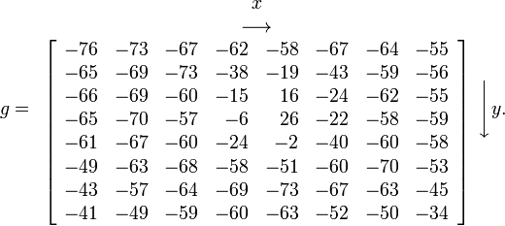
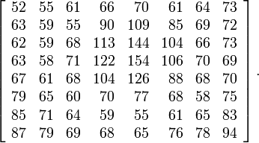
Zero-mean center
128 is subtracted from all pixels to zero-mean center the values
This is in preparation for the DCT

Slide 7
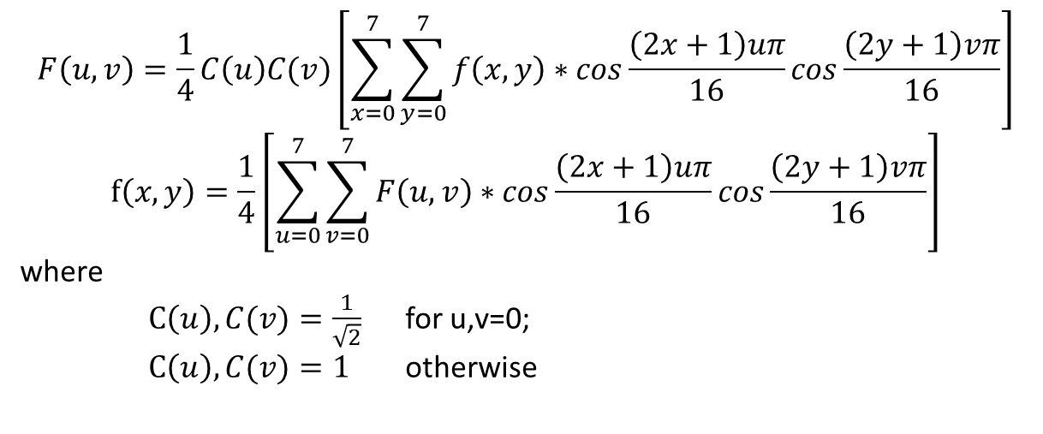
DCT and inverse DCT calculations
$$F\left(u,v\right)=\frac{1}{4}C\left(u\right)C(v)\left[\sum_{x=0}^{7}{\sum_{y=0}^{7}{f\left(x,y\right)∗cos\frac{\left(2x+1\right)uπ}{16}cos\frac{\left(2y+1\right)vπ}{16}}}\right]$$
$$f\left(x,y\right)=\frac{1}{4}\left[\sum_{u=0}^{7}{\sum_{v=0}^{7}{F\left(u,v\right)∗cos\frac{\left(2x+1\right)uπ}{16}cos\frac{\left(2y+1\right)vπ}{16}}}\right]$$
where
$C\left(u\right),C(v)=\frac{1}{\sqrt{2}}$ for u,v=0;
$C\left(u\right),C(v)=1$ otherwise

Slide 8
Forward DCT result
(DCT calculations)

Slide 9
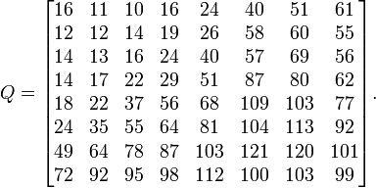
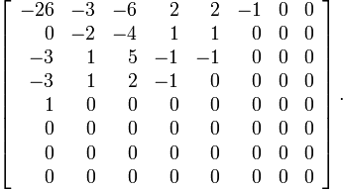
Quantization table (“Q” factor)
Every value divided by its Q table value; this is the real loss in the codec

Slide 10
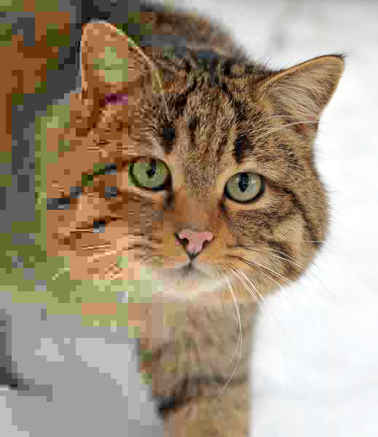
Quantization table (“Q” factor)
Q table is decreasing from left to right in this example

Slide 11
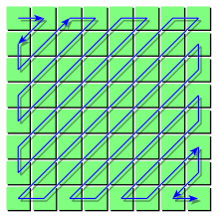
RLE, Huffman
RLE (a variety of it) encodes long sequence of zeros
Huffman (again, a variety) encodes non-uniformity of symbols
Differential encoding of DC coefficients (1st terms) separately encoded block to block

Slide 12
Discussion
Highly specialized codec, intended for photographs
ISO standard, freely available source code (library)
JPEG2000 uses wavelets instead of DCT
MPEG uses many of the same ideas

