Slide 1
Real-time scheduling, sharing resources
Adam Hoover

Slide 2
Outline
Problems of resource sharing
Basic priority inheritance protocol
Priority ceiling protocol
Highest locker protocol

Slide 3
Resource sharing
word
processor
web
browser
process
process
operating system
run
resource
Time slicing processes requires careful management of resource access

Slide 4
Resource locks
program #1
…
….
start using printer
….
end using printer
….
….
program #2
…
….
start using printer
….
end using printer
….
….
critical
code
(section)
critical
code
(section)
semaphore
mechanisms like semaphores provide mutual exclusion access (mutex)

Slide 5
Deadlock
time
task A
allocates R1
attempts to allocate R2
task B
higher
priority
preempts
allocates R2
attempts to allocate R1
tasks waiting on resources being used by other tasks in circular pattern

Slide 6
Priority inversion
time
still owns R1
R1 is freed
task A
allocates R1
task B
preempts
terminates
task C
blocking time
higher
priority
preempts
attempts to
allocate R1
allocates R1
priority inversion = higher priority task waiting on lower priority task
we seek to limit the maximum blocking time

Slide 7
Basic priority inheritance
If a task requests an unavailable resource, currently in use by a lower priority task,
then the lower priority task temporarily inherits the higher priority of the waiting task
Imagine being able to increase speed of slower car remotely...
dynamic priorities = task priorities can be altered by scheduler (O/S)

Slide 8
Basic priority inheritance
R1 is freed
prio(A) reset
prio(A)=prio(C)
task A
allocates R1
task B
preempts
terminates
task C
blocking
time
higher
priority
preempts
attempts to
allocate R1
allocates R1
terminates
task A gets temporary priority boost, reducing blocking time

Slide 9
Transitive inheritance
R1 is freed
prio(A) reset
prio(A)=prio(B)=prio(C)
task A
allocates R1
R2 is freed
prio(B) reset
allocates R1
prio(B)=prio(C)
task B
preempts
allocates R2
attempts to
allocate R1
terminates
task C
blocking time
higher
priority
preempts
attempts to
allocate R2
allocates R2
terminates
priority inheritances can cascade, extending blocking time

Slide 10
Priority ceiling protocol
Each resource has a ceiling priority = highest priority of any task that uses it.
System ceiling = highest ceiling priority of any resource currently in use.
task | priority | resources used
A | P1 | R1
B | P2 | R1, R2
C | P3 | R2
resource | ceiling priority
R1 | P2
R2 | P3
higher
priority
On any resource request, the task must either:
have a priority > current system ceiling, or
own the resource setting the current system ceiling
If request denied, blocking task temporarily inherits priority of requesting task

Slide 11
Priority ceiling protocol example
system
ceiling
0
P2
P3
P2
P3
0
0
prio(A)=prio(B)
R1 is freed, prio(A) reset
task A
allocates R1
allocates R1
task B
preempts
attempts to
allocate R2
preempts,
allocates R2
terminates
task C
R1 freed
R2 freed
higher
priority
preempts
allocates R2
R2 freed
terminates
priority requests checked against ceiling protocol tests

Slide 12
Highest locker protocol
Each resource has a ceiling priority = highest priority of any task that uses it.
System ceiling = highest ceiling priority of any resource currently in use.
task | priority | resources used
A | P1 | R1
B | P2 | R1, R2
C | P3 | R2
resource | ceiling priority
R1 | P2
R2 | P3
higher
priority
On any resource request, the task must either:
have a priority > current system ceiling, or
own the resource setting the current system ceiling
If request denied, blocking task temporarily inherits priority of requesting task
If granted, requesting task temporarily inherits the resource’s ceiling priority + 1

Slide 13
Highest locker protocol example
system
ceiling
0
P2
P3
P2
0
P3
0
prio(A)=P2+1
R1 is freed, prio(A) reset
task A
allocates R1
preempts
allocates R1
task B
cannot
preempt
allocates R2,
prio(B)=P3+1
terminates
task C
R1 freed
R2 freed
prio(B) reset
higher
priority
preempts
allocates R2,
prio(C)=P3+1
R2 freed,
prio(C) reset
terminates
acquired resources cause immediate priority changes

Slide 14
Ceiling/locker protocols
Both eliminate deadlocks
Both reduce maximum blocking time
Each task can only be blocked once per resource
Locker protocol changes priorities more often but has fewer task switches
A set of tasks is schedulable if:
$$∀$$
i=1…n
let k=1…i
$$\left\lfloor \frac{T_{i}}{T_{k}}\right\rfloor$$
let l=1…
max blocking
$$\sum_{j=1}^{i−1}{\left((R_{j}+O)\left\lceil \frac{lT_{k}}{T_{j}}\right\rceil \right)}+R_{i}+B_{i}≤lT_{k}$$
for some (k,l)

Slide 15
How to see priorities (linux)
ahoover@apollo01> ps -e -o uid,pid,ppid,pri,ni,cmd | more
UID PID PPID PRI NI CMD
0 1 0 19 0 /sbin/init
0 2 0 19 0 [kthreadd]
0 9 2 139 - [migration/0]
0 47 2 39 -20 [netns]
0 49 2 19 0 [khungtaskd]
0 50 2 39 -20 [writeback]
0 51 2 14 5 [ksmd]
0 52 2 0 19 [khugepaged]
...
priority
niceness
linux priorities are combinations of (a) user vs system tasks, (b) scheduler used, and (c) niceness levels used to make adjustments within a small range
‘nice’ and ‘renice’ commands can be used to adjust priorities at startup and during execution, respectively

Slide 16
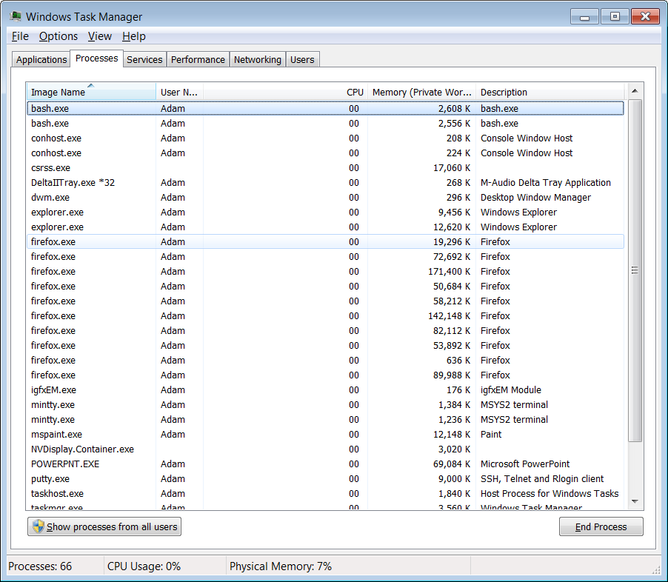
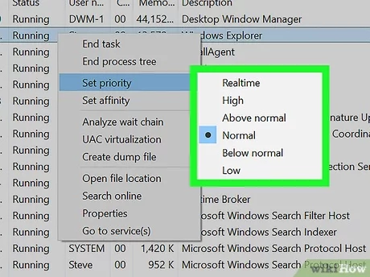
How to see priorities (windows)
priority
niceness
CTRL-ALT-DEL ….. Start task manager
…right-click task

